Slide 1
Intel’s makers community board design with Fusion360
Gil Tal.
Sep 2022

Slide 3
Course agenda:
Basics (very basics) electronics
What is a PCB?
Board producing process
Schematic
Design rules
The Physical Board
Placement
Routing
Production
Board power on and debug

Slide 4
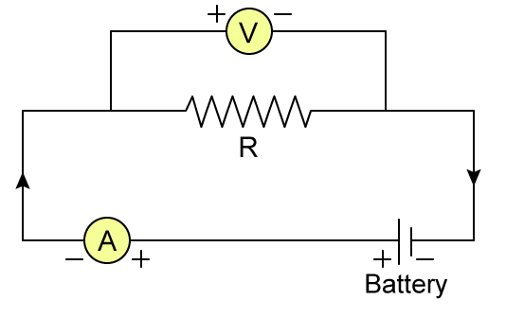
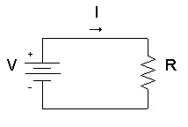
OHM law
V = R*I (URI)

Slide 5
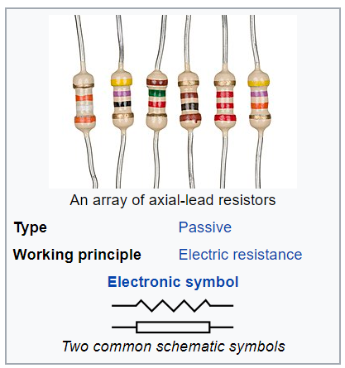
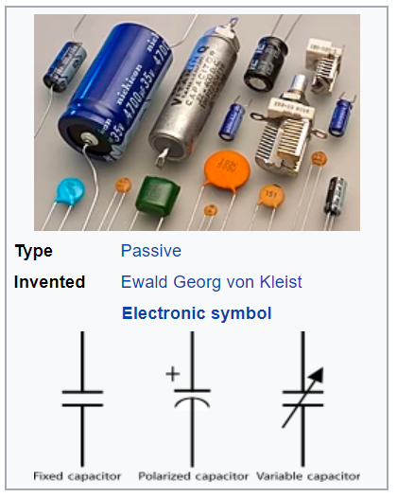
Basic components
A resistor is a passive two-terminal electrical component that implements electrical resistance as a circuit element.
Basically, turns electrical energy into heat.
Measure unit: ohm
Usages: Limit current, drop voltage level, Pull up/down floating signals
A capacitor is a device that stores electrical energy in an electric field. It is a passive electronic component with two terminals.
Measure unit: Farad
Usages: Handle power supply surge, very fast absorption of electrical energy (also fast discharge), along with a resistor a simple reset at power on

Slide 6
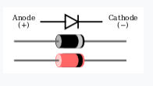
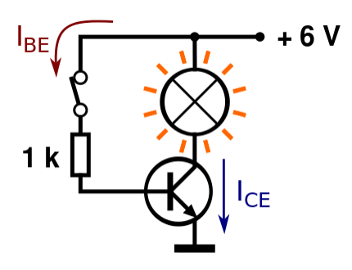
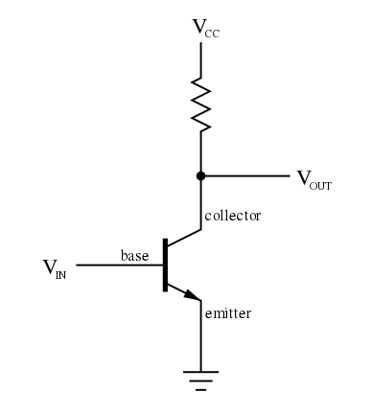
A diode is a two-terminal electronic component that conducts current primarily in one direction (asymmetric conductance); it has low (ideally zero) resistance in one direction, and high (ideally infinite) resistance in the other.
A transistor is a semiconductor device used to amplify or switch electronic signals and electrical power

Slide 7
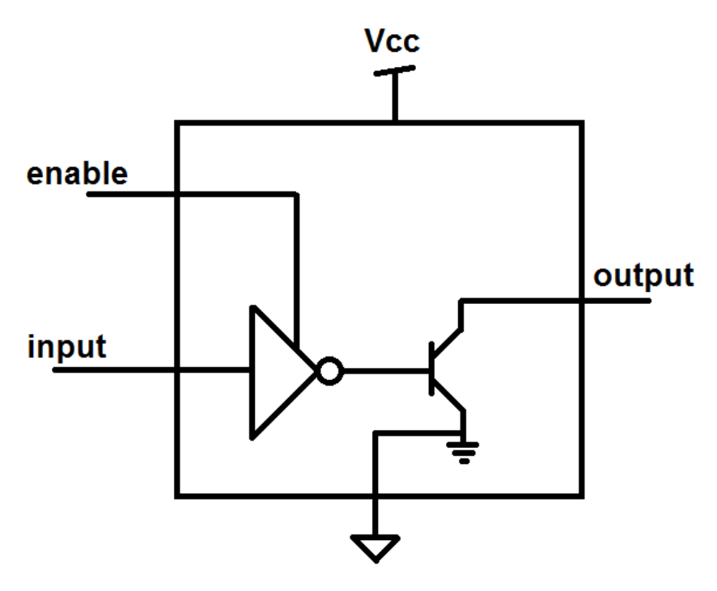
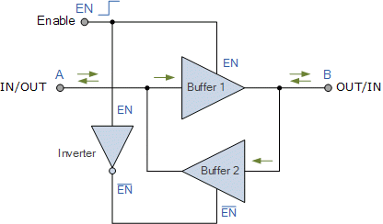
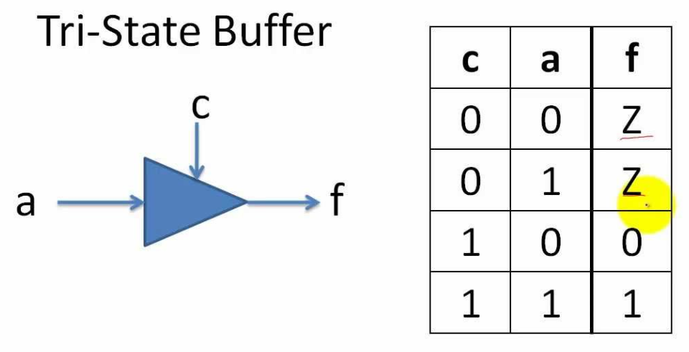
Open drain buffer: Either short to ground or float the output
A pull up resistor is needed to drive logic 1
Bi-Directional I/O
Tri state buffer:

Slide 8
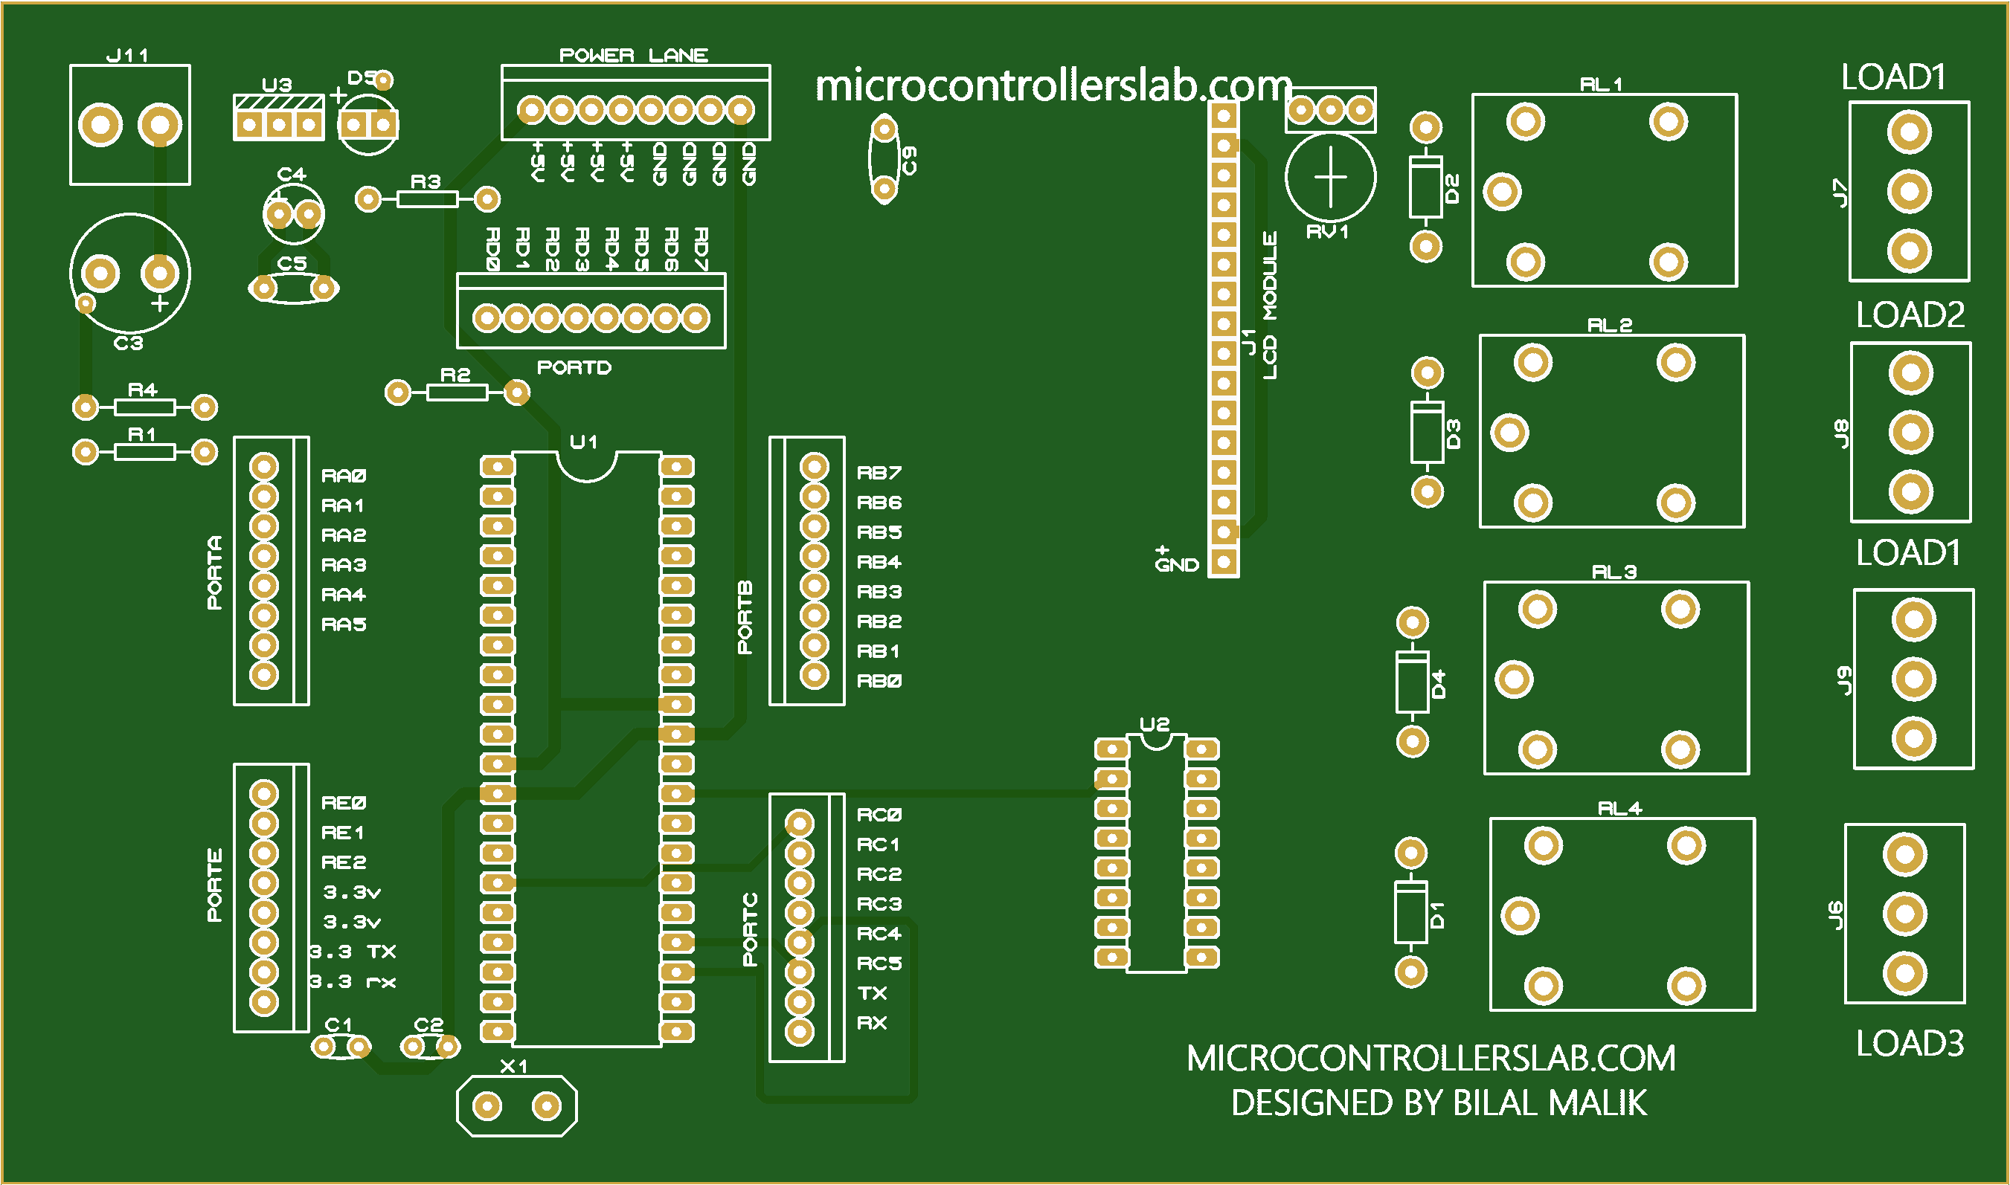
PCB
Printed circuit board
Mechanically supports and electrically connects electrical or electronic components
Using conductive tracks, pads and vias
May be composed from few layers of copper laminated onto and/or between layers of a non-conductive substrate

Slide 9
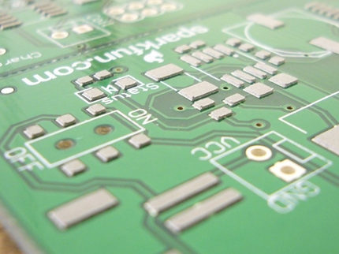
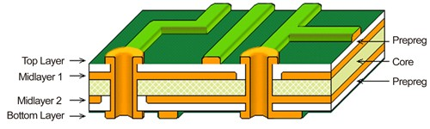
PCB - Structure
Standard thickness 1.6mm
Suggested trace width for cheap PCBs 5-6 mil (check with manufacturer)
Via connects traces between different layers
Pads are used for soldering devices
Pads
Via
Trace
Via
Via

Slide 10
Board producing process
Block diagram
Components
Pick up
Schematic
ERC +
Netlist
Board
creation
Placement
Set rules
For routing
Assembly
Purchase
components
Send board
To production
Generate
Production
Files
DRC
Routing
Power On
☺

Slide 11
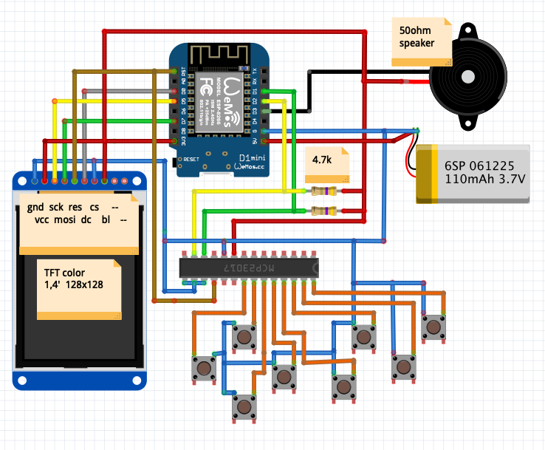
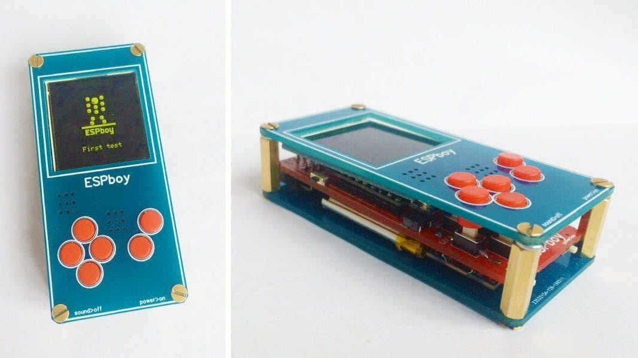
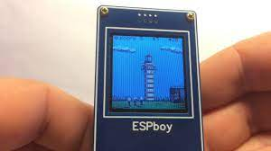
Schematic – Step 1
Draw a block diagram (ESPboy)

Slide 12
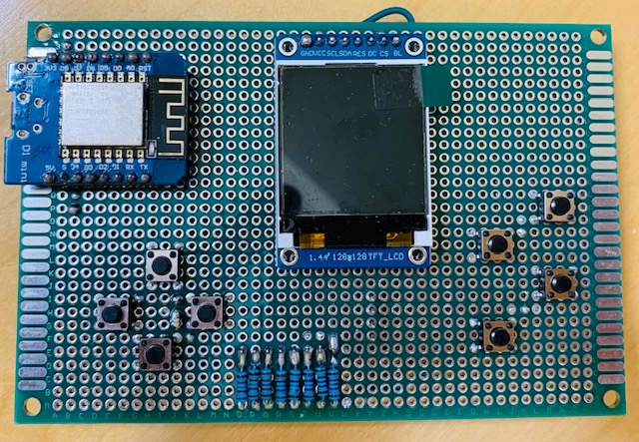
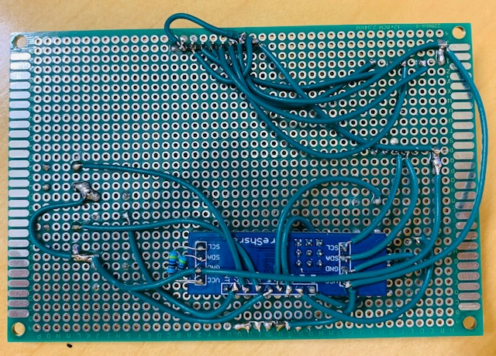
ESPboy

Slide 13
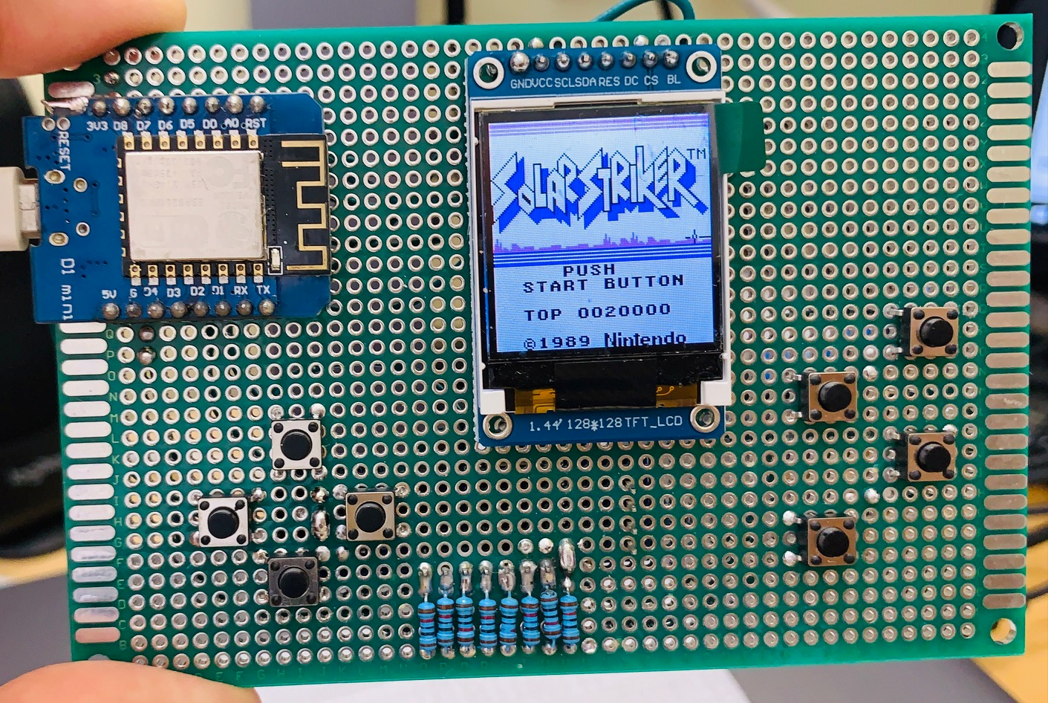

Slide 14

Components pickup:
I/O Voltage
What types of I/Os does it have
Power supply voltage
Type of packages (Next slide)
Type of I/Os (especially open drain needs attention)
Does it use an output enable? If yes check polarity
Does it need reset? If yes check polarity
Does it need a pull up\dows for some of its signals? (interrupts for example)
Does it have a sample at reset pins?
Check if it has I/Os that functions differently under reset?
For I2C devices check their address

Slide 15
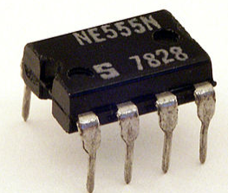
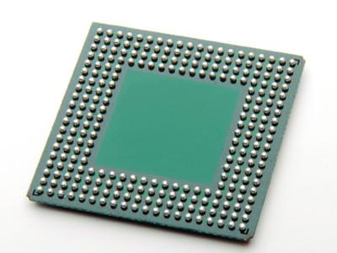
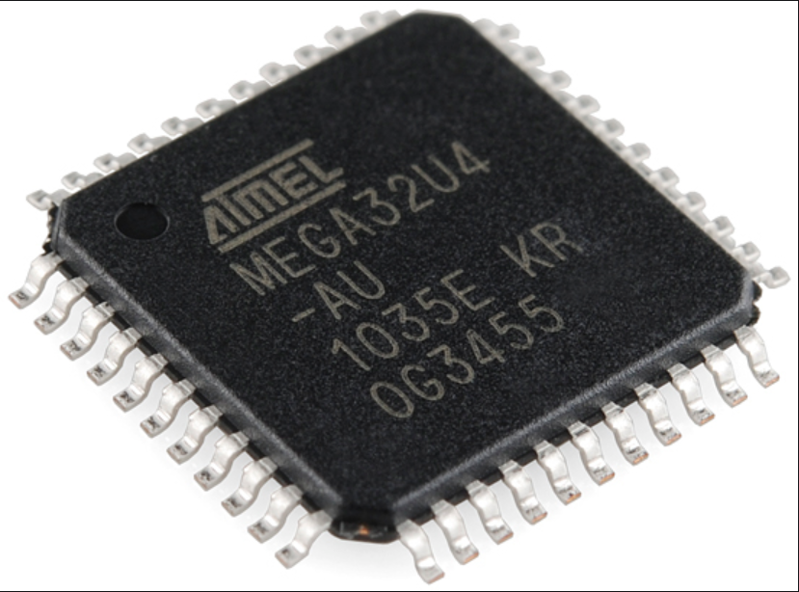
Different types of packages
Through hole (TH)
SMT (Surface Mount)
BGA (Ball Grid Array)

Slide 16
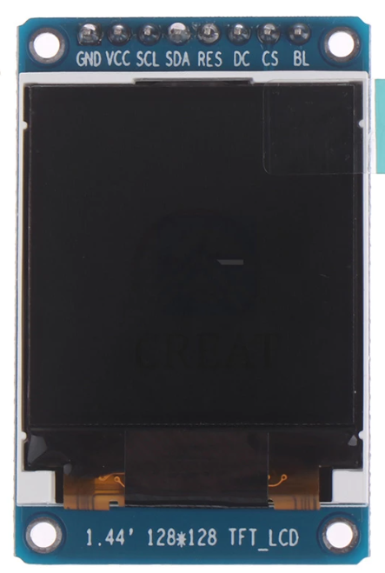
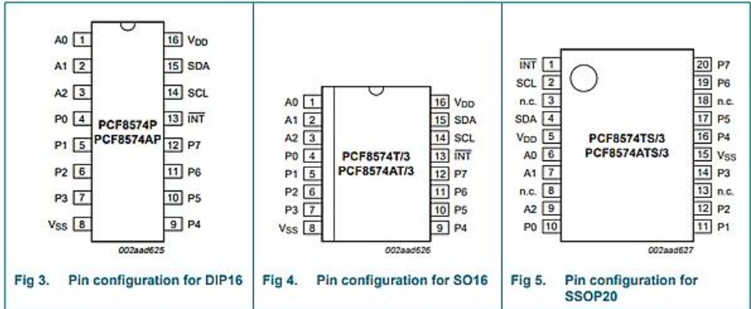
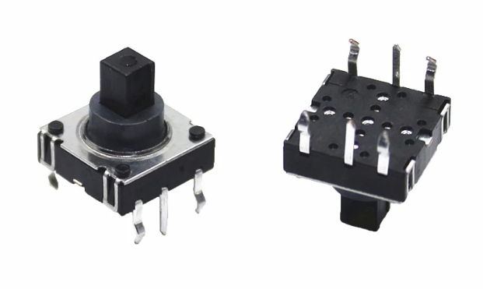
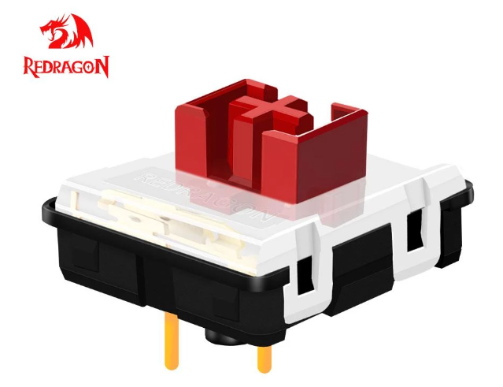
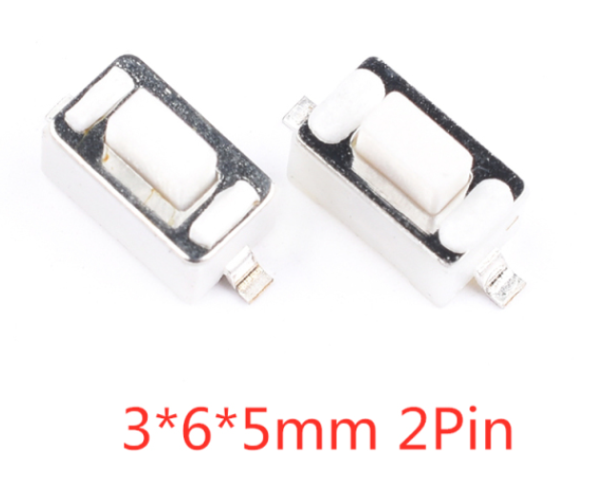
What we need for the ESPboy?
ESP8266 module
LCD screen: 1.44” 64K colors, SPI interface
I/O expander, I2C interface, PCF8574
Tactile joystick
2 low profile cherry-MX buttons
2 SMT switches
Buzzer

Slide 17
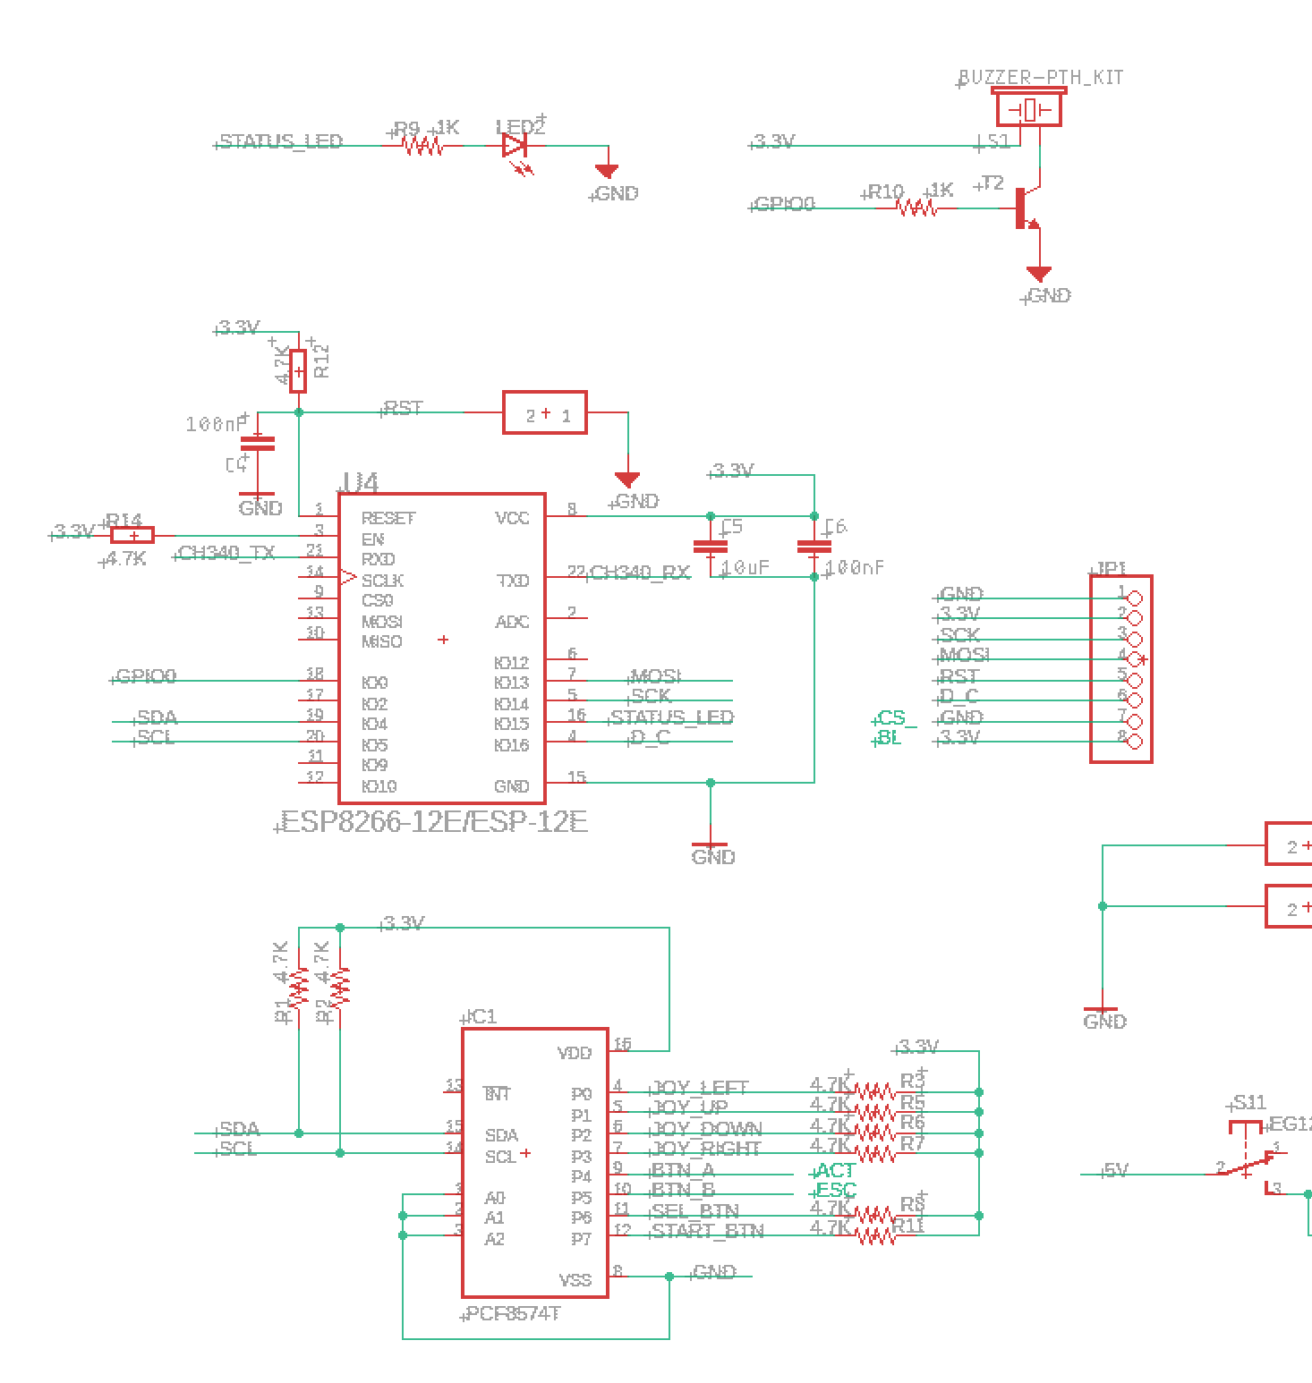
Schematic – Rules and caveats
Two outputs cannot be connected to each other
  It can happen without paying attention
Do not leave a floating input signals
I/Os voltage level must be suitable
  Some devices has I/Os that can tolerate high voltage
Special I/Os needs special attention:
  Open drain must have pull ups (interrupts)
  I/Os which have output enable must have a pull up/down
  Sample at reset I/Os
Most component need a capacitor\s placed near the power supply
I2C devices addresses needs coordination

Slide 18
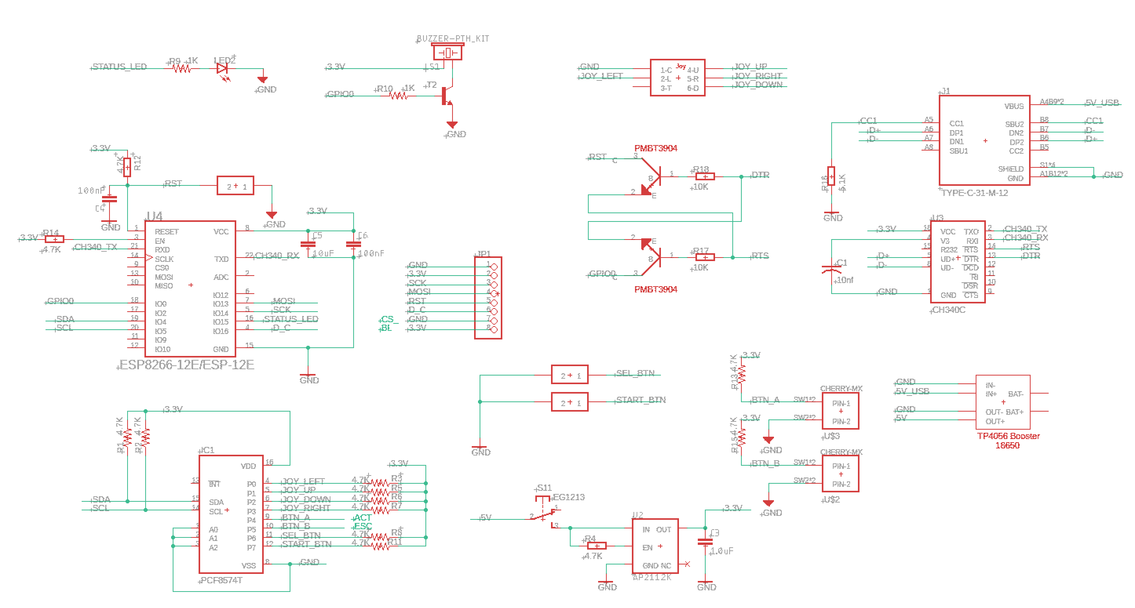
Schematic – Step 3
Create a new project in Eagle
  Draw your schematic
  Components needed must be in the library

Slide 19

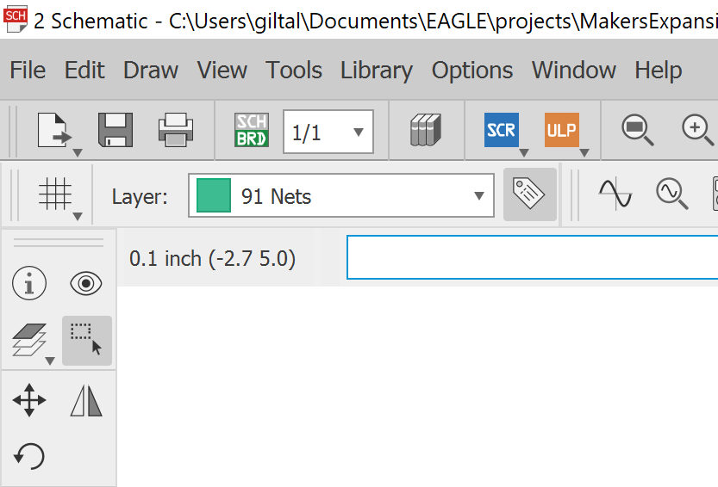
Board – Step 1
In Eagle generate the board

Slide 20
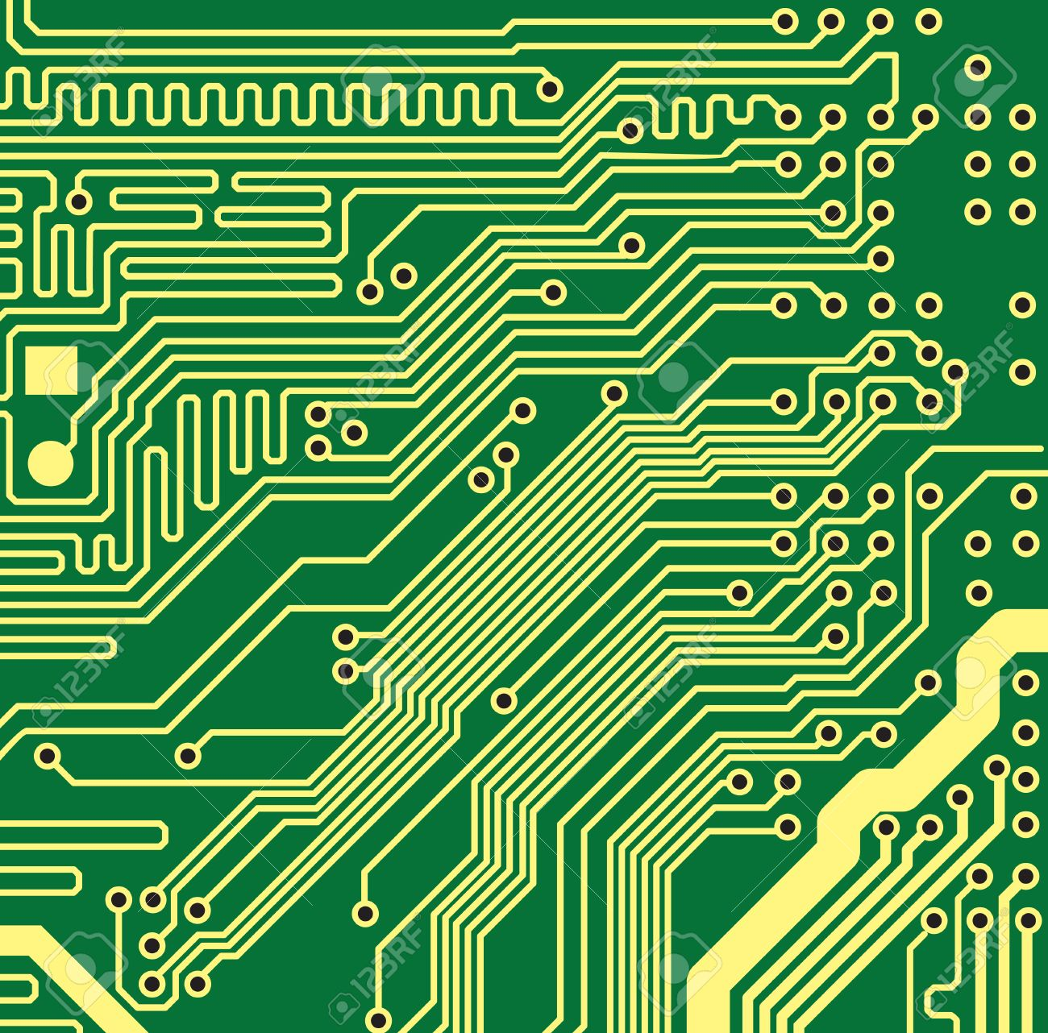
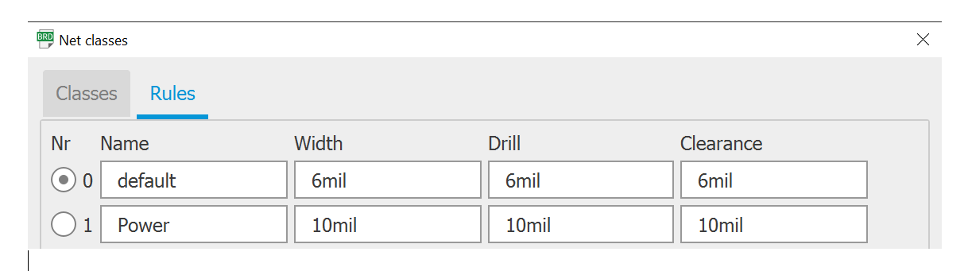
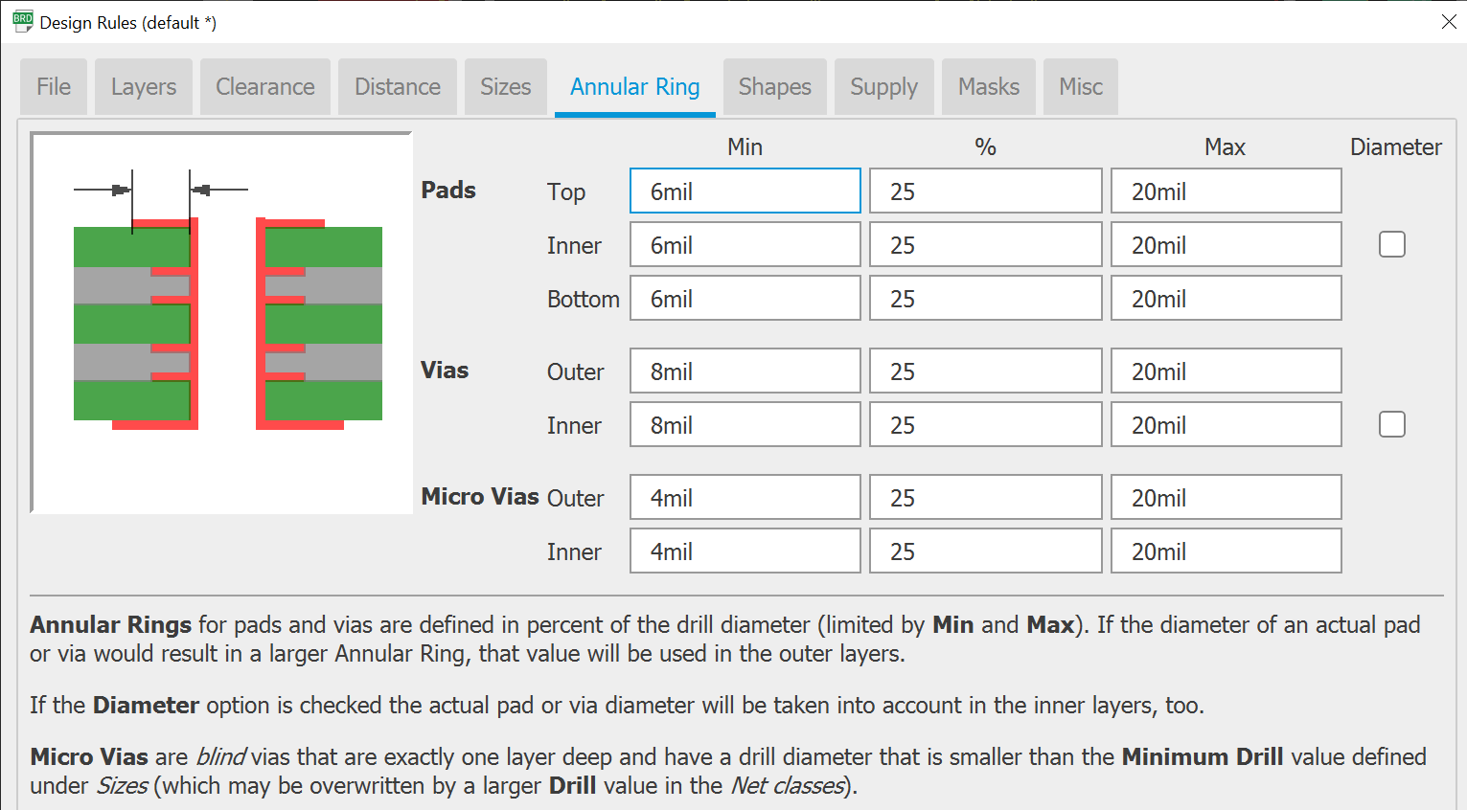
Board – Step 2
Set
the physical size of the board
Set
the number of layers (default is 2, we will not use more than 2)
Set
the net classes: (Edit->Net classes)
Power
Regular signals (default)
Custom if needed
Set
the project’s general settings:
Edit->Design Rules

Slide 21

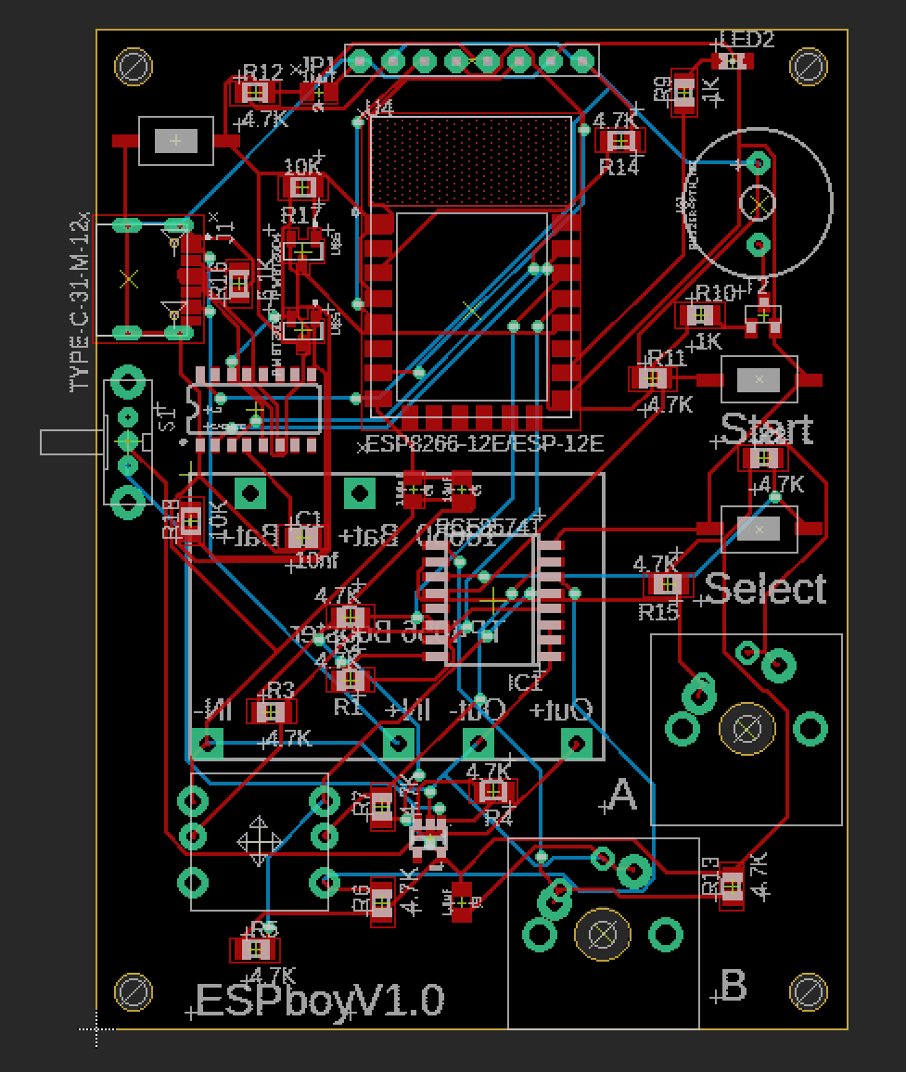
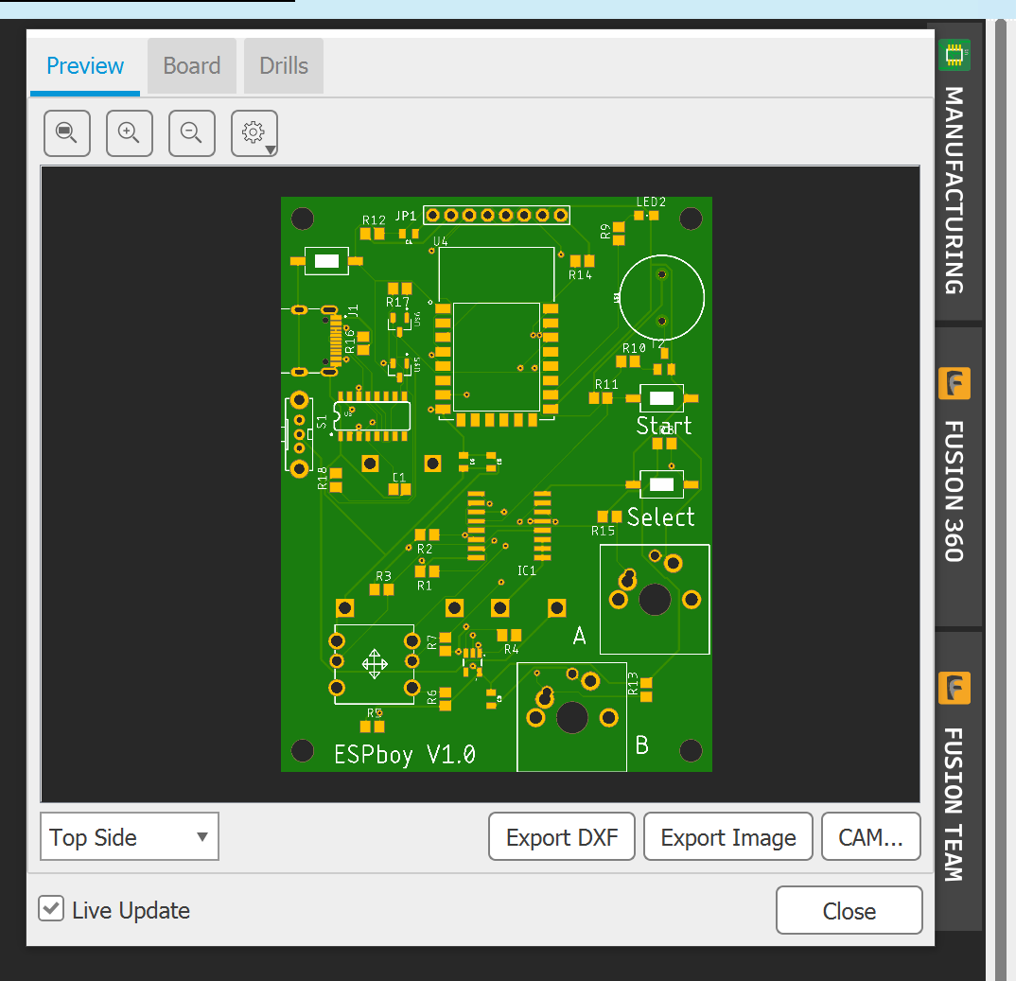
Board – Step 3 (Placement)
Locate your components on the physical board
Try to keep them all on the components side (upper layer)
Set drills for mounting
Do a placement physical check
  Print the board in 1:1 ratio (Also use the manufacturing view)
Create planes if needed

Slide 22
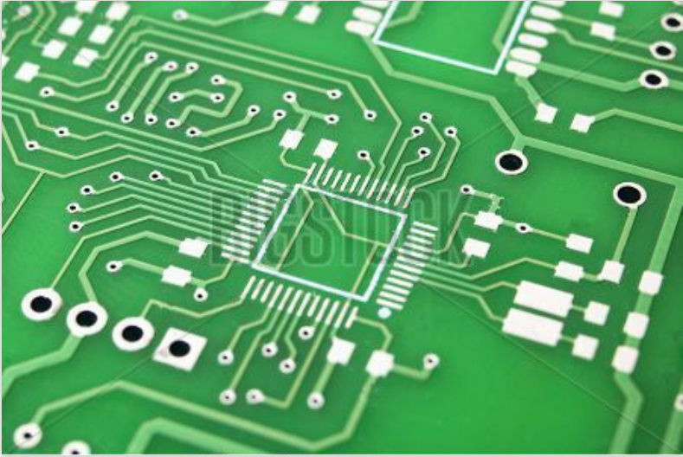
Board – Step 4
Routing:
Net List check (if not done yet)
Route (use the auto router)
Complete un routed signals
Fix whatever is needed
Run an ERC/DRC check
Add text (tPlace \ bPlace only!)
Generate the production file
Send to production and prayer ☺

